Slide 1
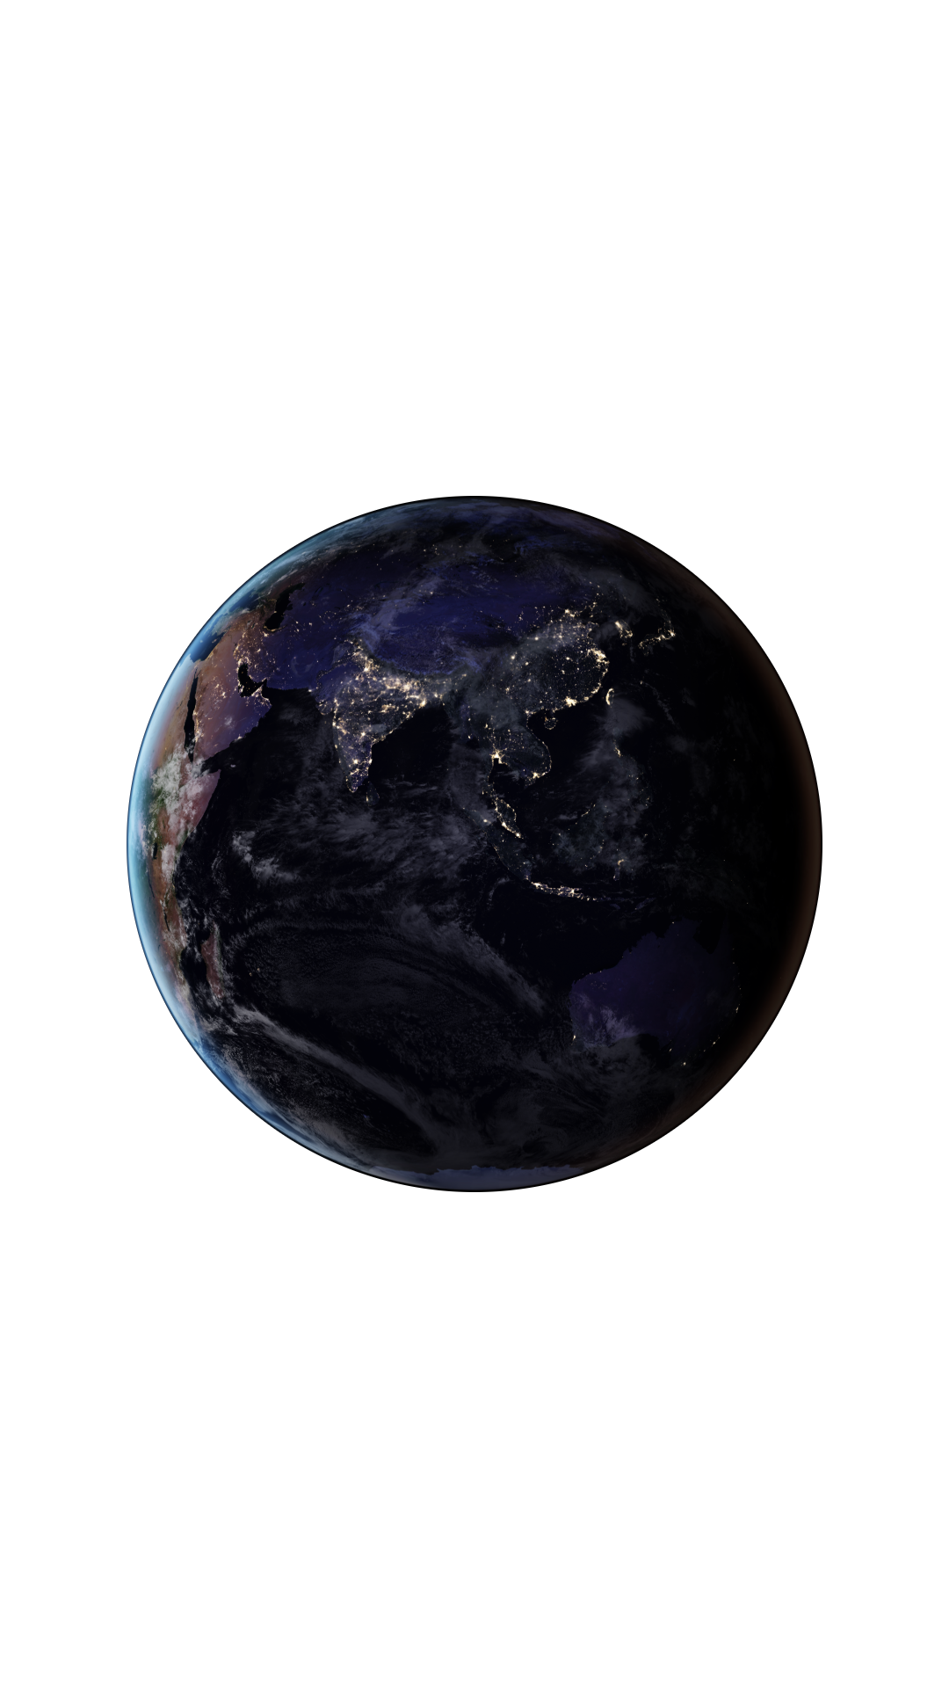
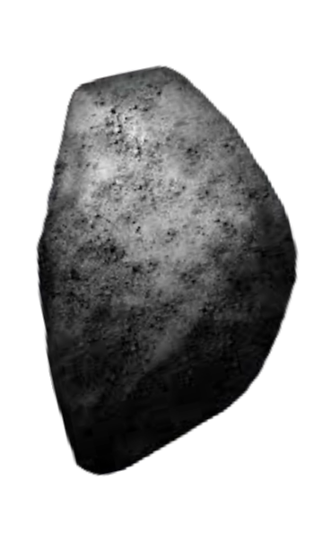

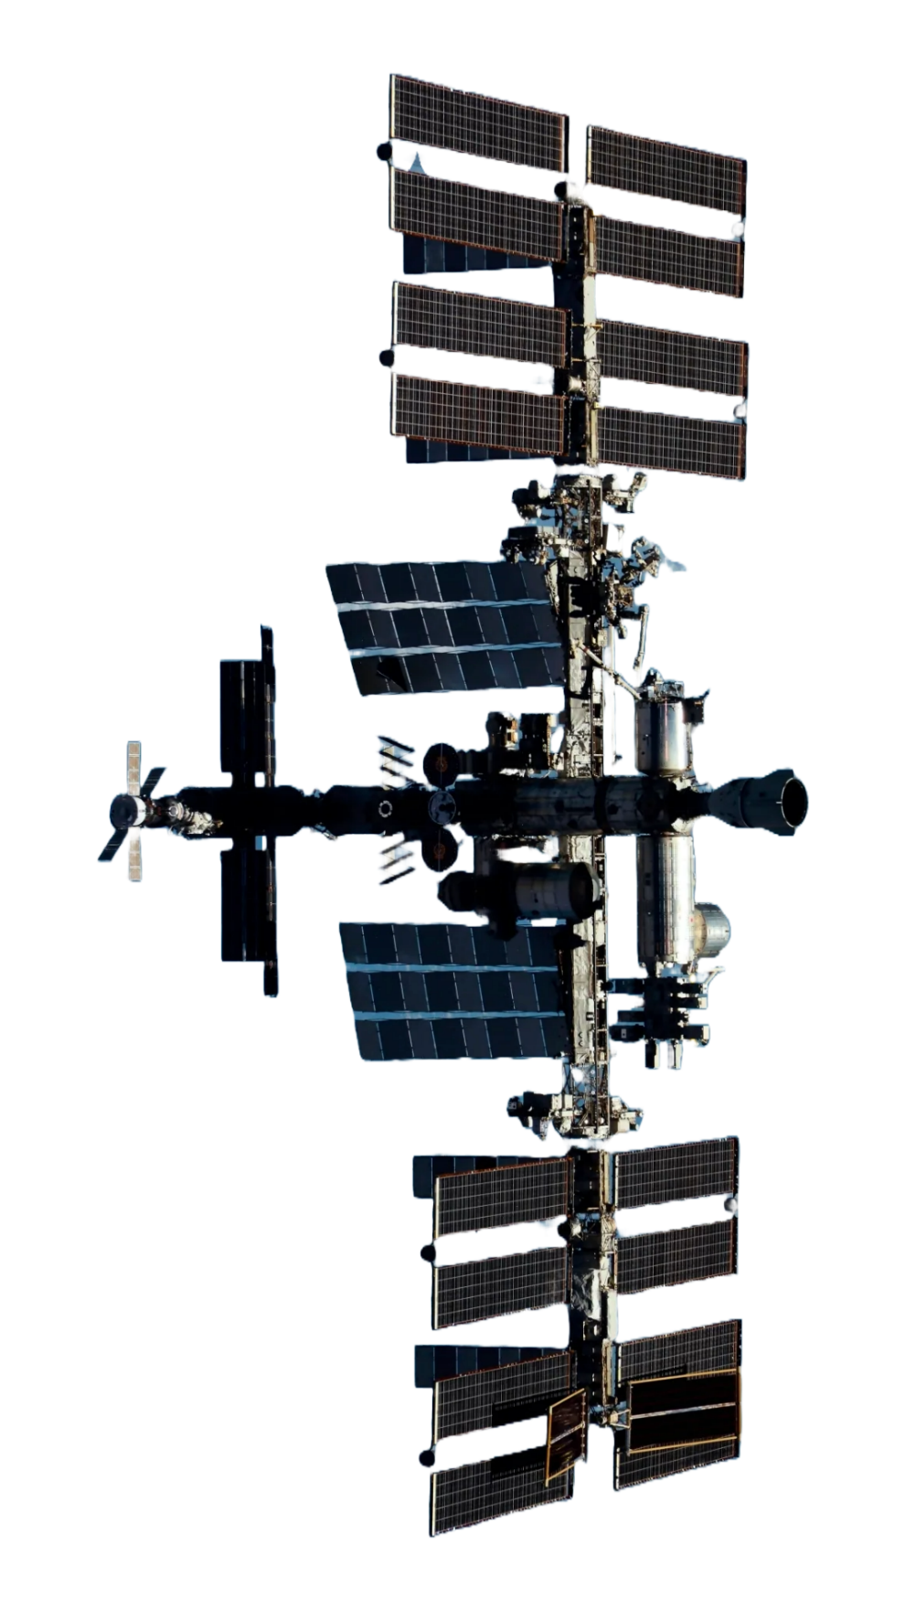
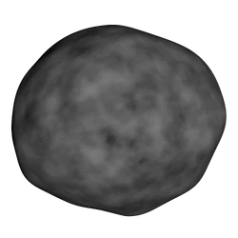
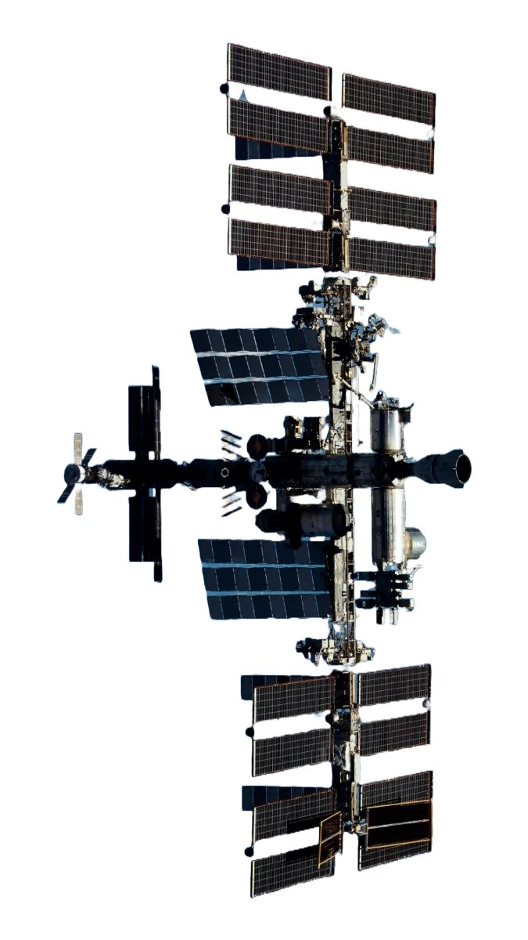
MISSION
ABOUT
OUR MISSION
PLANET
CONTACT
Provide an interactive platform to explore and visualize Near-Earth Objects (NEOs) in real-time.
Offer accurate, accessible data on NEOs and their orbits.
Raise awareness of planetary defense and space science.
Engage and educate the public about astronomical phenomena.
ASTROSCOPE
ORRERY WEB APP :
REDEFINING SPACE AWARENESS
BY:
YASHAVANTH K B
SAMARTH D KOLUR
ASHWIN K P
ASHMITHA NATH
VARSHINI M G
VISMITHA H M
KEY POINTS
Real-time tracking of NEO positions and movements.
Enhance understanding of NEO risks and scientific value.
Ensure an intuitive, visually engaging, and accessible platform.

Slide 2
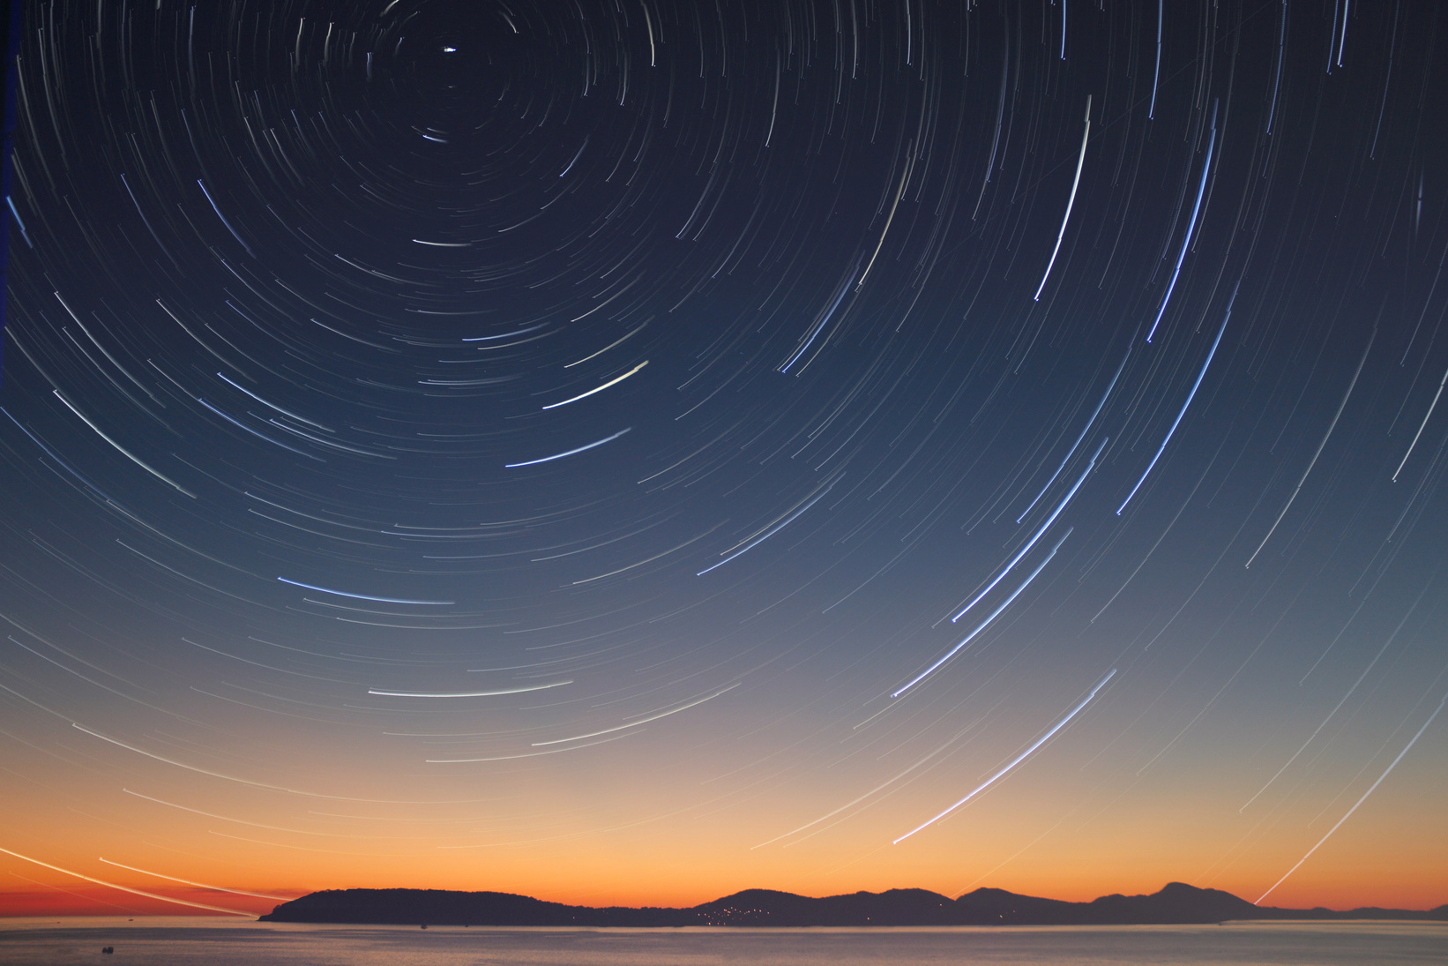
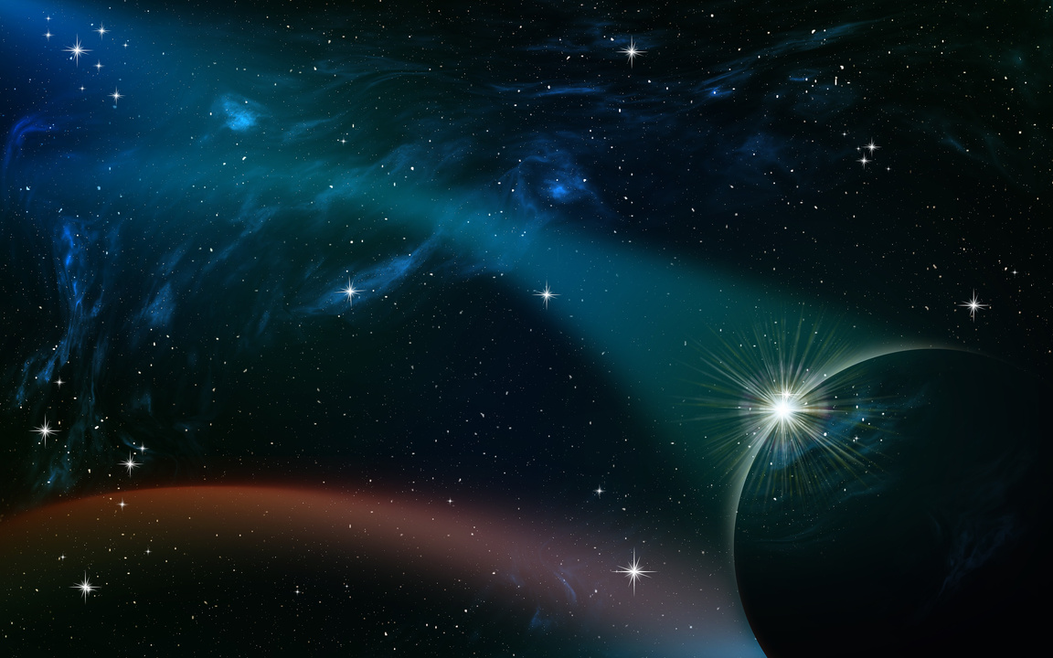
HTML , CSS , JS , Three JS , PYTHON
MISSION
KEY POINTS
LANGUAGES USED :
Real-time tracking of NEO positions and movements.
Enhance understanding of NEO risks and scientific value.
Ensure an intuitive, visually engaging, and accessible platform.
Provide an interactive platform to explore and visualize Near-Earth Objects (NEOs) in real-time.
Offer accurate, accessible data on NEOs and their orbits.
Raise awareness of planetary defense and space science.
Engage and educate the public about astronomical phenomena.
OPEN SOURSES :
GIT , GITHUB , NASA RESOURCES

Slide 3
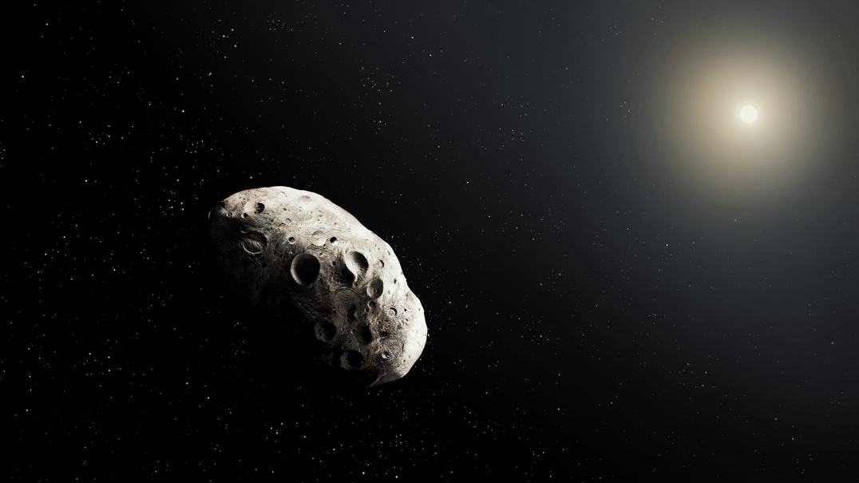

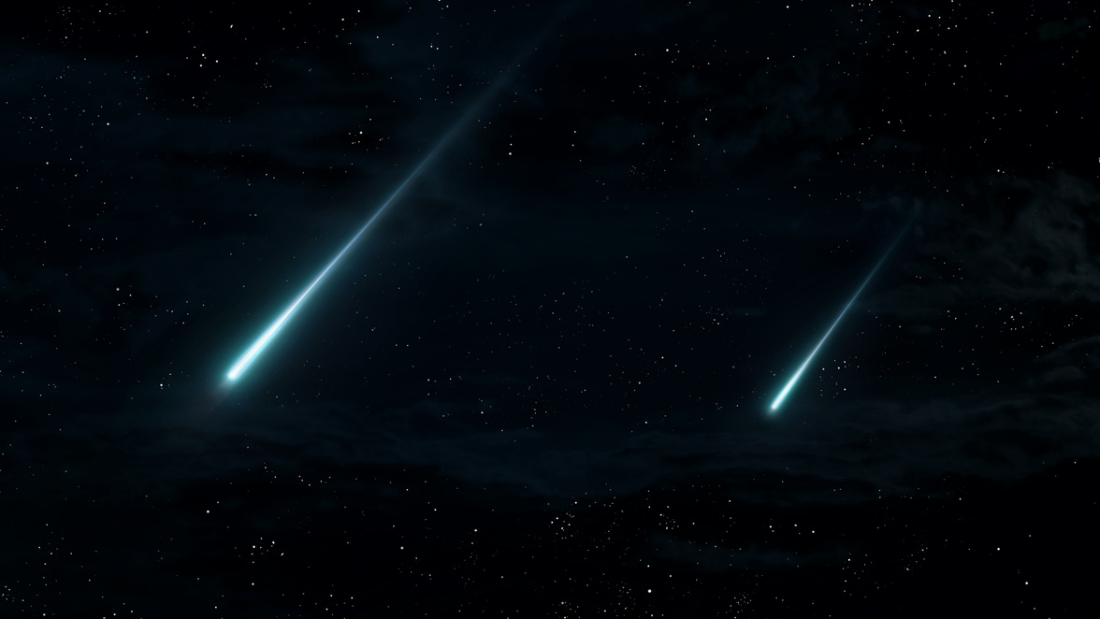
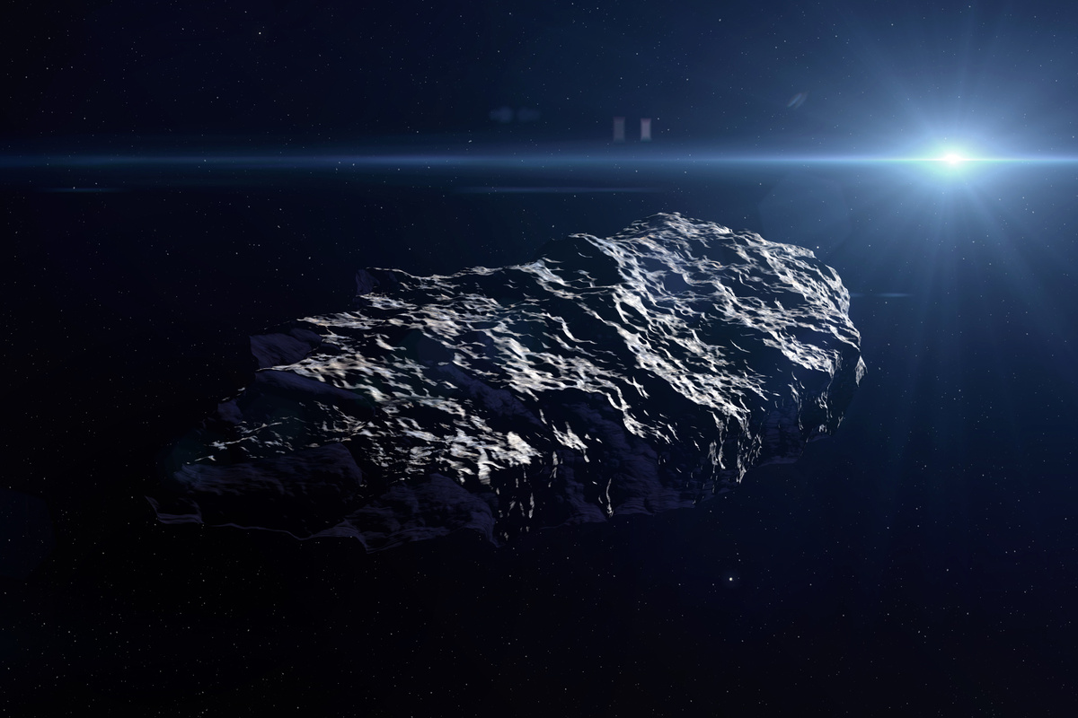
ASTEROIDS , COMETS & METEOROIDS
LANGUAGES USED :
HTML , CSS , JS , Three JS , PYTHON
OPEN SOURSES :
ASTEROID BELT
GIT , GITHUB , NASA RESOURCES
METEOROIDS
Users can move forward or backward in time to observe the asteroid’s past and future positions, including close approaches to Earth.
The app can provide real-time tracking of meteoroids entering Earth’s atmosphere, including data on bright meteors (fireballs) and their origins.
KUIPER BELT OBJECTS
COMET TAILS
Alerts can inform users when a comet will be visible in the night sky, enhancing public engagement and interest in astronomical events.
The Orrery could also track spacecraft missions to the Kuiper Belt, like NASA's New Horizons, and visualize their paths relative to KBOs.

Slide 4
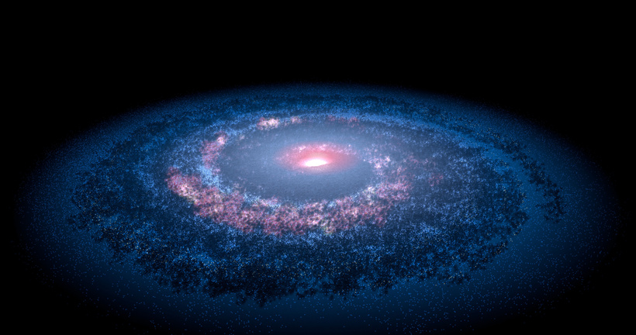

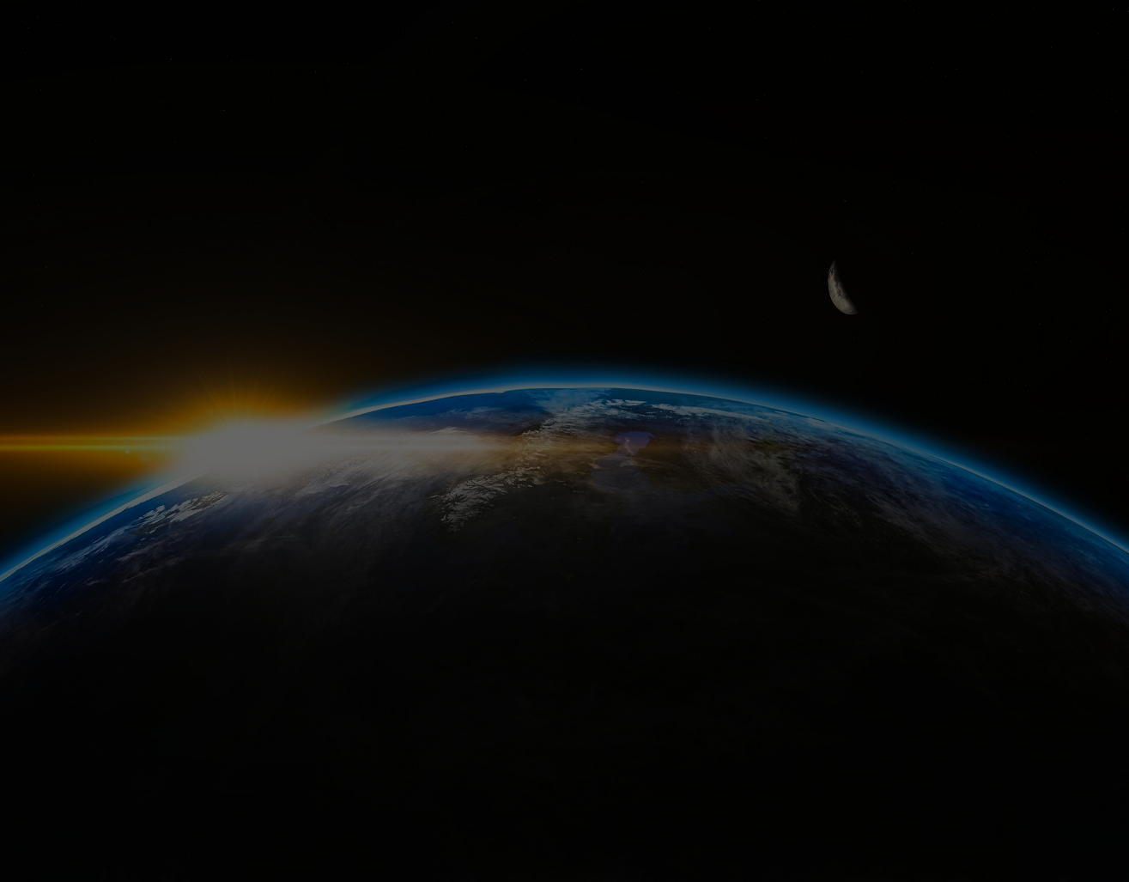
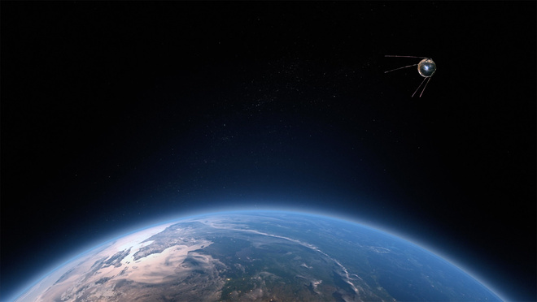
ORRERY WEB APP IN NASA
ASTEROIDS , COMETS & METEOROIDS
Education and Public Outreach
Data Visualization
Mission Planning
Enhancing Citizen Science
Scientific Research
CONCLUSION
ASTEROID BELT
COMET TAILS
KUIPER BELT OBJECTS
METEOROIDS
Users can move forward or backward in time to observe the asteroid’s past and future positions, including close approaches to Earth.
Alerts can inform users when a comet will be visible in the night sky, enhancing public engagement and interest in astronomical events.
The Orrery could also track spacecraft missions to the Kuiper Belt, like NASA's New Horizons, and visualize their paths relative to KBOs.
The app can provide real-time tracking of meteoroids entering Earth’s atmosphere, including data on bright meteors (fireballs) and their origins.
The Orrery Web App combines educational content, real-time tracking, and interactive visualization to enable meaningful engagement with astronomical phenomena. As exploration of the cosmos continues, the app will be a vital tool for scientists, educators, and space enthusiasts, helping to clarify the universe and inspire future generations to explore the stars with curiosity and wonder.

Slide 5
THANK YOU!
ORRERY WEB APP IN NASA
Education and Public Outreach
Data Visualization
Mission Planning
Enhancing Citizen Science
Scientific Research
CONCLUSION
The Orrery Web App combines educational content, real-time tracking, and interactive visualization to enable meaningful engagement with astronomical phenomena. As exploration of the cosmos continues, the app will be a vital tool for scientists, educators, and space enthusiasts, helping to clarify the universe and inspire future generations to explore the stars with curiosity and wonder.
ASTROSCOPE
GET IN TOUCH WITH US

Slide 6
THANK YOU!
GET IN TOUCH WITH US
ASTROSCOPE

